Slide 1
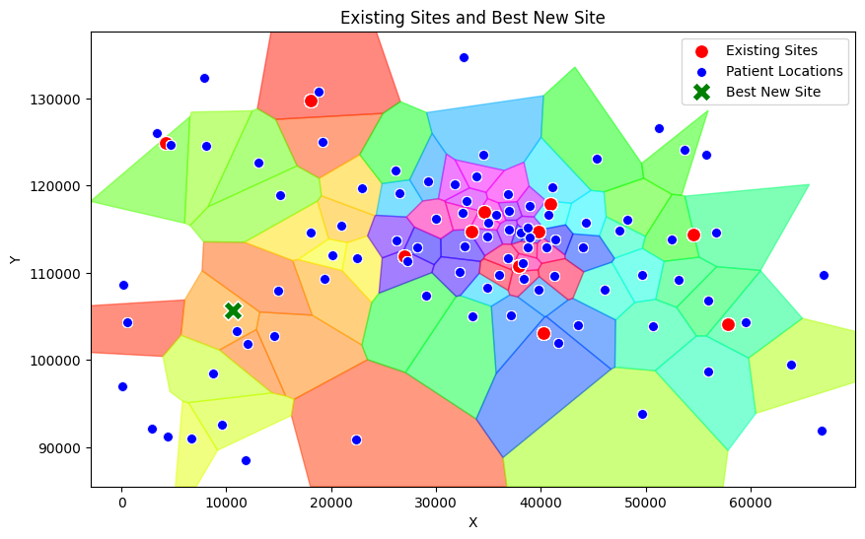
Business Report
Optimizing Accident & Emergency (A&E) Department Locations
Camilla Andreozzi, Glauco Rampone
University of Glasgow, Mathematics & Statistics
Introduction
This report presents the outcomes of the Undergraduate Operational Research Challenge for Public Health Scotland.
The project’s goal was to optimize the locations for two new A&E departments to address patient wait times effectively.
Two distinct solutions were identified, each focusing on a unique objective:
Centrally Located A&E Department
Strategically Located A&E Department
Coordinates:
Coordinates:
Objective: Achieve the largest total reduction in patient wait times and driving times.
Key Insights: Location was selected using Voronoi mapping and analysis of patient distribution. This solution focuses on areas with the highest patient volumes and longest wait times. Benefits are concentrated in specific regions.
Key Metrics:
Average Wait Time Reduction: 25,000 minutes
Average Distance to Nearest A&E: 8 km
Percentage of patients benefiting from the solution: 100%.
Benefits: Maximizes the system’s overall efficiency. Provides targeted relief in high-demand areas.
Challenges: The model assumes that patients always choose the nearest department. As a result, patients in the city center may not experience substantial benefits under this assumption.
Objective: Reduce wait times and driving times for all patients uniformly across the region.
Key Insights: Location was selected using Linear, Poisson and Gamma models. This solution addresses the overarching need for equitable healthcare access. It is designed to ease the pressure on all other departments.
Key Metrics:
Average Wait Time Reduction:
Average Distance to Nearest A&E: 10 km
Percentage of patients benefiting from the solution: 100%.
Benefits: Enhances the overall equity of patient care. Addresses system-wide inefficiencies.
Challenges: Works under the assumption that the main demand will be always concentrated in the center. May not achieve the maximum possible reduction in total wait time.
Combined Solutions
Key Metrics:
Average Wait Time Reduction: 15minutes
Percentage of Patients with Reduced Wait Time: 95%
Average Distance to Nearest A&E: 10 km

